Slide 1


Formes Psychiatriques de Maladies Neuro-Métaboliques
Qu’ont elles à nous apprendre ?
Olivier Bonnot,
Unité Universitaire de Psychiatrie de l’Enfant et de l’Adolescent
CHU de Nantes
u2pea.free.fr & olivier.bonnot@chu-nantes.fr
Hérédité en Fête, Paris 2 octobre 2013

Slide 2
Conflit d’intérêt
Actelion (laboratoire du Zavesca, traitement du NPC): Honoraires et participations a des colloques.
Aucun autre pour cette présentation

Slide 3
Intro
MNM sont rares ET complexes
Les recherches portent principalement sur les traitements et la physiopathologie
Les signes psychiatriques sont un champs négligé
Les psychiatres s’en désintéressent
Les neurologues ne les connaissent pas

Slide 4
MAIS
BCP de pathologies organiques sont associée aux TSS ou autres Tb Psy…
Parfois les signes PSY sont les SEULS signes
Malheureusement une connaissance complète du champs de l’organicité en psy est impossible

Slide 5

EXAMPLE : Main Association Schiz-Organicity
Nutritional deficiency
Pellagra (Vitamin B3 deficiency) | Biermer (Vit B12 deficiency) Bushman 99 | Other Vit deficiency ?
Endocrine diseases
Addison Disease | Cushings Disease Hirsh 2000 | Dysregulation of Thyroid and Hyper Parathyroid
Inborn errors of metabolism
Homocysteine Metabolism Disorders (MTHFR and CBs)Reif 2005 Wilson’s Disease Wichovicz 2006 | Urea Circle Disorders Porphyria Ellencweig 2006 | Niemann-Pick type C Xanthomatosis
Infectious diseases
Cerebral abscess | Encephalitis (HSV ++) | Neuro-Syphilis
Auto-immune diseases
Chorea / Multiple Sclerosis | Lupus / Sarcoidosis | NMDA
Chromosomal abnormalities Mac Carthy, Nat Genet 2009; Ingason, Mol Psy, 2011; Abdolmaleky, Am J Med Genet 2005, Stefansson, Nature 2009; Levinson, Am J Psy 2011
1q21, 2p53, 2q29, 15q11.2, 15q11.3, 17q12, 22q11.2 | NRXN1 (Neurexin 1) | 7q36.3, 25q11-13, 16p11.2, 16p13.1
Other CNS diseases | Toxic | Medication
Epilepsy
? %

Slide 6
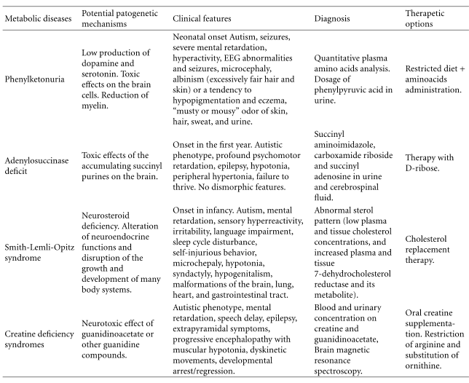


EXEMPLE
Principales MNM associées aux TSA
Serotonin Deficiciency : Autism / OCD …

Slide 7
En pratique
3 Cas

Slide 8
Patient 1
Patient 1 was a 13-year-old boy at his first admission in a psychiatric setting
Early development was unremarkable
Age 6:
      tendency to fall frequently as well as clumsiness in writing and fine movements.
      Impairments in drawing, writing, spelling and mathematics
He became hyperactive, impulsive and sometimes violent.
He was, however, able to attend regular school despite his learning difficulties
and behavioral disturbances

Slide 9
Patient 1
Age 13
      hospitalized after an episode of aggressiveness towards his mother
      subsequently admitted to a day-hospital for four years.
Borderline intelligence associated with dysgraphia, ADHD predominant hyperactive-impulsive subtype and oppositional defiant disorder (ODD)
Histoire classique de patient psychiatrique

Slide 10
Patient 1
Qqs symptomes physiques dans ces ATCD (rares)
  pes cavus à 13 ans, tarsectomie antérieure bilaterale
  Diarrhée chronique

Slide 11
Patient 1
Il est SERIEUSEMENT examiné à 18 ans
  Réponse plantaire en extension,
  Atrophie musculaire partie distale antero-externe du MI.
  Hypoesthésie distale sous le genoux
  EMG: polyneuropathie distale sensori-motrice.
  IRM normale…

Slide 12
at least
Dg fait à 21 ans !
Plasma cholestanol was found to be elevated (ratio cholestanol:cholesterol=1:100, N<1:1000).
Sequencing of the CYP27A1 gene in the patient and his parents revealed that he had the Arg 395 / Cys point mutation inherited from his mother and the Arg 479 / Cys point mutation from his father.
XCT
Treatment with chenodeoxycholic acid (250 mg, three times a day).

Slide 13
Patient 1
Other biological abnormalities (1.3 g/L with 1.60<N<2.60 g/L), low HDL (0.40 g/L with 0.40<N<0.65 g/L) and LDL (0.40 g/L with 0.70<N<1.40 g/L) and high triglycerides (2.75 g/L with 0.45<N<1.90 g/L).
Mild lens opacity
A second MRI showed mild hyperintensities in both dentate nuclei of the cerebellum.
MR spectroscopy : elevation of choline and inositol at the level of the centrum semiovale. Cerebellar peaks were within normal limits.
Treatment with chenodeoxycholic acid (250 mg, three times a day) was then started.

Slide 14
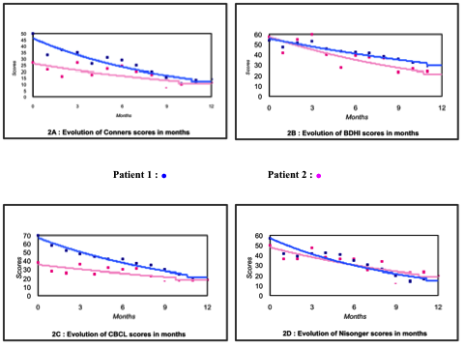
IMPROVEMENT IN BEHAVIOUR WITH NO PSYCHOTROPIC MEDICATION !!!
Amélioration Comportementale sans aucun psychotrope

Slide 15
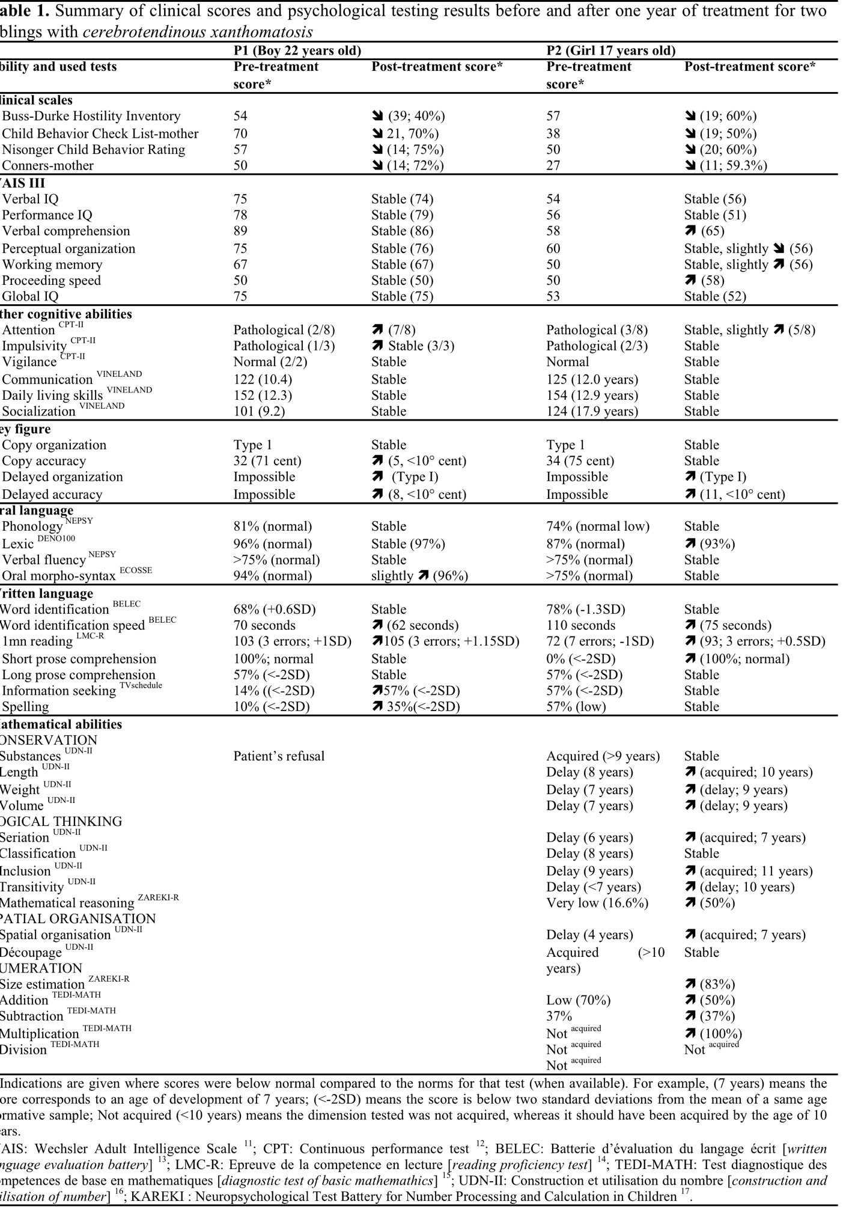
IMPROVEMENT IN COGNITION
Mieux sur le plan Instrumental !!!

Slide 16
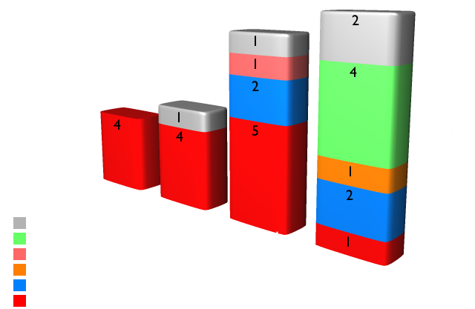
Older patients have more specific psychiatric signs

Slide 17
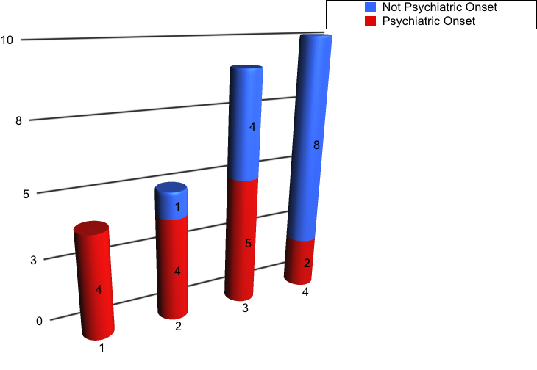
In early onset CTX, Psy Signs are mosty isolated
BUT: 10-15 % of psychiatric signs….
Childhood
Adolescence
Early Adulthood
Late Adulthood
En préparation Fraidakis, Bonnot, Sedel…

Slide 18
Example 2 :
Garçon de 8 ans Dg de TSA
Hallucination auditives à 15 ans Dg DSM IV de Schizophrénie
Quietapine non efficace and risperidone partiellement efficace sur les hallucinations
Examen neurologique à 16 ans: Paralysie Supra-Nucléaire
Confusionnant non ?
Cas comme des milliers en psychiatrie... ?
Presque
Sandu et al., 2009

Slide 19
Un frère et une soeur
Garçon de 22 ans
Etats Psychotiques Brefs sous cannabis
14 hospitalisation en 4 ans pour les mêmes raisons
Dg de Schizophrénie
AP pas très efficaces
Hanon et al, 2013

Slide 20
25 ans…
Bave (AP ?) dysarthrie (AP ?°
Mouvements anormaux (AP, chorée)
Regard perdu… (schiz ?)
Baisse des fct cognitives (AP ?)
Aucune amélioration en baissant les AP, ou changeant de molécules….

Slide 21
26 ans
Mouvements choréodystoniques
Syndrome cérébelleux
Dysmétrie / Dysarthrie
Syndrome Frontal
PSN
Niemann Pick Type C
Improvement of Psychotic symptoms with no other treatment than Miglustat

Slide 22
His Sister
BPE at age 22
5 hospitalizations
No cannabis
AP inefficient
Dg is Schizophrenia
Swallow disorders, distal trembling, walk impairment
Molecular Dg only one of the two mutation of his brother (Asn1156Ser) = No NPC ? No treatment

Slide 23
QUICK REVIEW OF DISEASE
Less case report published
Multidisciplinary approach is rare
Descriptions are of low quality
80% are diagnoses in chidren but an increasing number of IEM is diagnoses in adulthood
Systematic Review

Slide 24
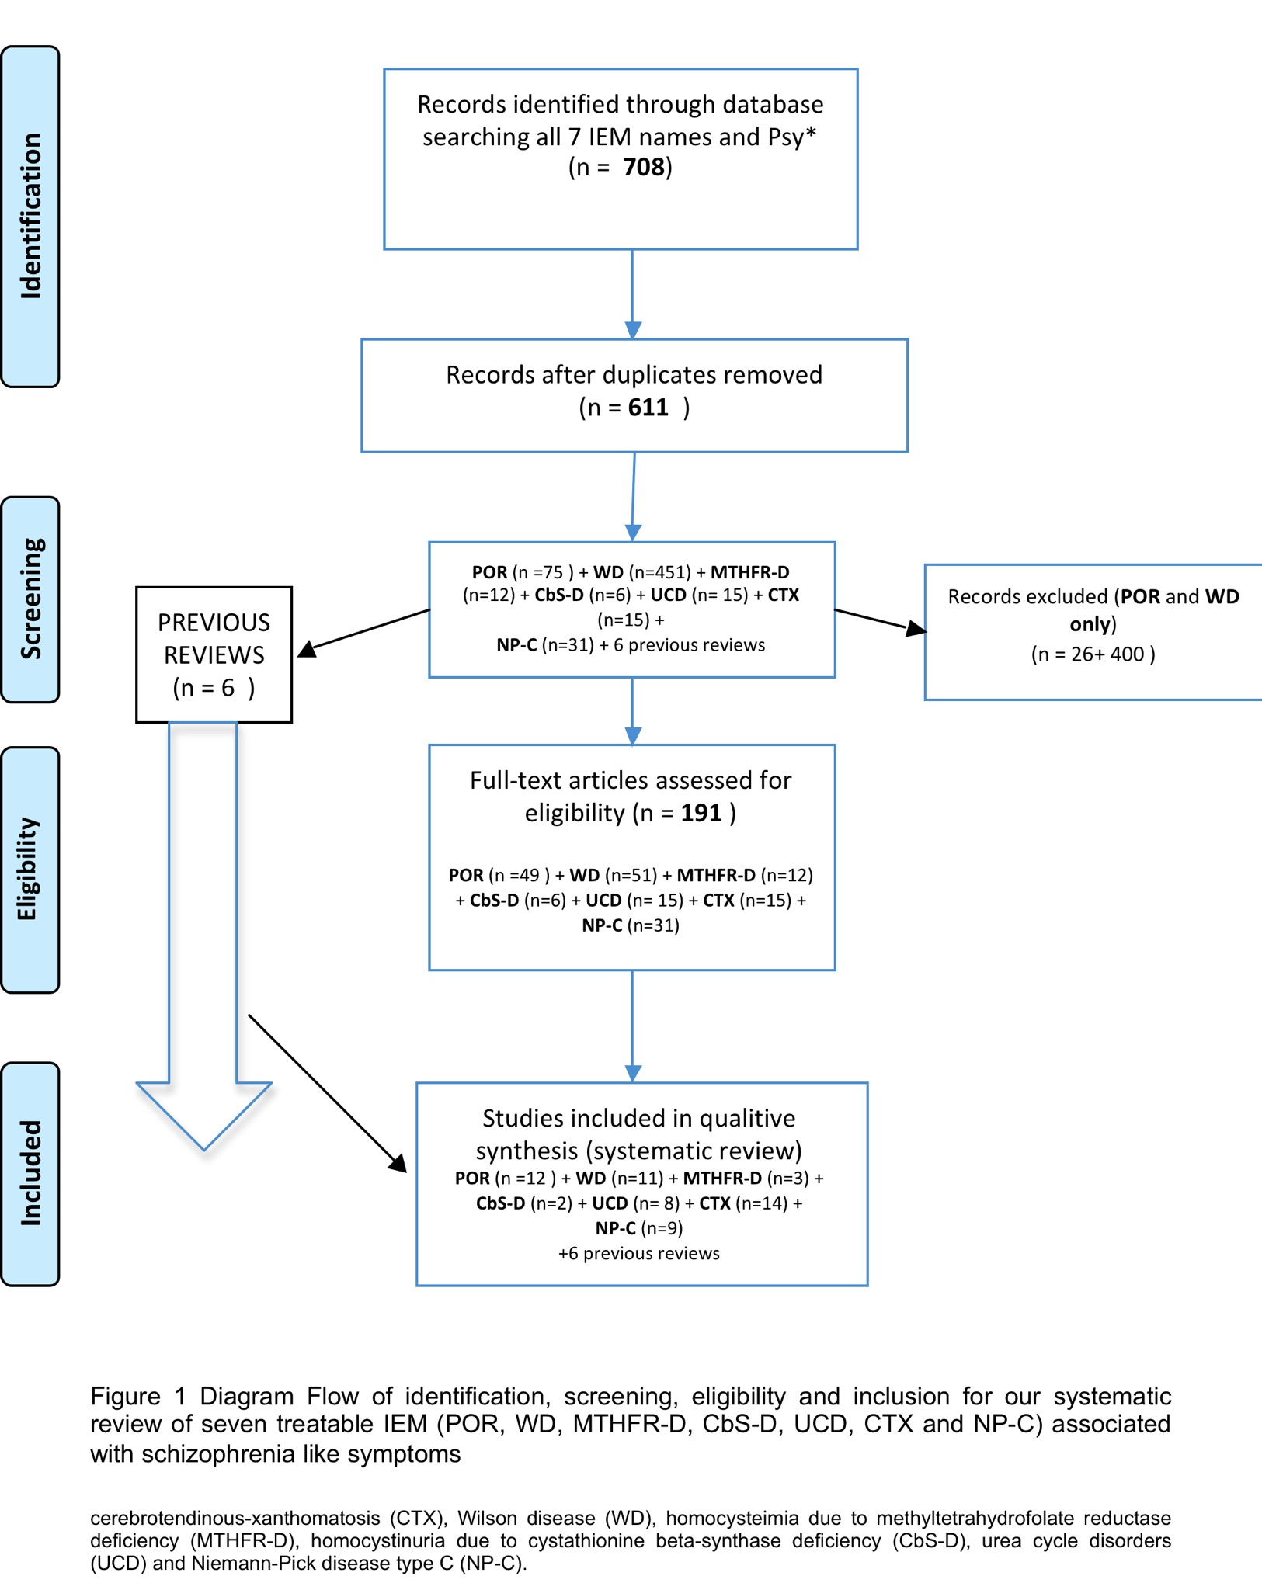
Bonnot, Walterfang et al, Clinical Journal of Psychiatry submitted
Walterfang, Bonnot et al, J In Errors Metabol, 2013 in press

Slide 25
CbS
Episodic depression (10%), chronic disorders of behavior (17%), obsessive-compulsive disorder (5%), and personality disorder (19%) (n=63)
Aggressive behavior
A 31 year old woman presented with a three week history of delirium and inappropriate and labile affect
Abbott et al. Am J Med Genet 1987 Apr;26(4):959-969. Li SC & Stewart PM. Pathology 1999 Aug;31(3):221-224.

Slide 26
MTHFR
Insidious
Acute (after surgery) with visual and/or auditory hallucinations, thought disorder and delusions.
Unipolar depression, schizophrenia and bipolar disorders (MTHFR C677T gene variant )
Not uncommun
Mattson et al. Trends Neurosci 2003 Mar;26(3):137-146. Roze E et al. Arch Neurol 2003 Oct;60(10):1457-1462. Gilbody S et al, American journal of epidemiology 2007 Jan 1;165(1):1-13.

Slide 27
Moreover
Folic acid is a water-soluble B-vitamin involved in the synthesis, repair and methylation of DNA (epigenetic regulation)
Deficiency of B-vitamins leads to an increased level of homocysteine, which is a highly toxic metabolite to neural and vascular development
Elevated serum levels of homocysteine have also been shown to be associated with schizophrenia,
Friso et al. Current drug metabolism 2005 Feb;6(1):37-46. et al. Schizophr Res 2005 Jan 1;72(2-3):79-90. Regland et al. Progress in neuro-psychopharmacology & biological psychiatry 2005 Sep;29(7):1124-1132. O'Donnell C et al. Am J Psychiatry 2005 Jul;162(7):1387-1388; author reply 1388-1389. Muntjewerff et al. Mol Psychiatry 2006 Feb;11(2):143-149.

Slide 28
Urea Circle Disorders
Psychosis as presentation is possible
Atypical Depressions
Late onset UCD may be presenting with a psychiatric (essentially behavioral and with hallucination) and organic signs, especially vomiting
Anorexia – like disorders with protein refusal Aggravation : Protein // Youth// Valproate // Corticoïdes
Arn et al. N Engl J Med 1990 Jun 7;322(23):1652-1655. Enns et al. Obstetrics and gynecology 2005 May;105(5 Pt 2):1244-1246. Bachmann et al. European journal of pediatrics 2003 Jun;162(6):410-416. Krivitzky et al. Pediatric research 2009 Jul;66(1):96-101. Legras et al. Critical care medicine 2002 Jan;30(1):241-244. Myers et al. The American journal of emergency medicine 1996 Oct;14(6):553-557 Panlaqui et al. Intensive care medicine 2008 Oct;34(10):1922-1924. Thurlow et al Annals of clinical biochemistry 2010 May;47(Pt 3):279-281.

Slide 29
WD
Between 6y et 20 y++++
Psychiatric Signs 50 % --- Preseting 20 % ++++
Schizophrénie like in 10 % - Worsted with AP ++++ (even if chelator)
But also MDD / BPD / change in Personnality and behavoiur
Visuo-Saptial Impairement and Memory Loss. Executive function Rathbun, 1986; Medalia, 1989
  Portala et al., 2002; Dening et al., 1989 & Akil et al., 1995

Slide 30
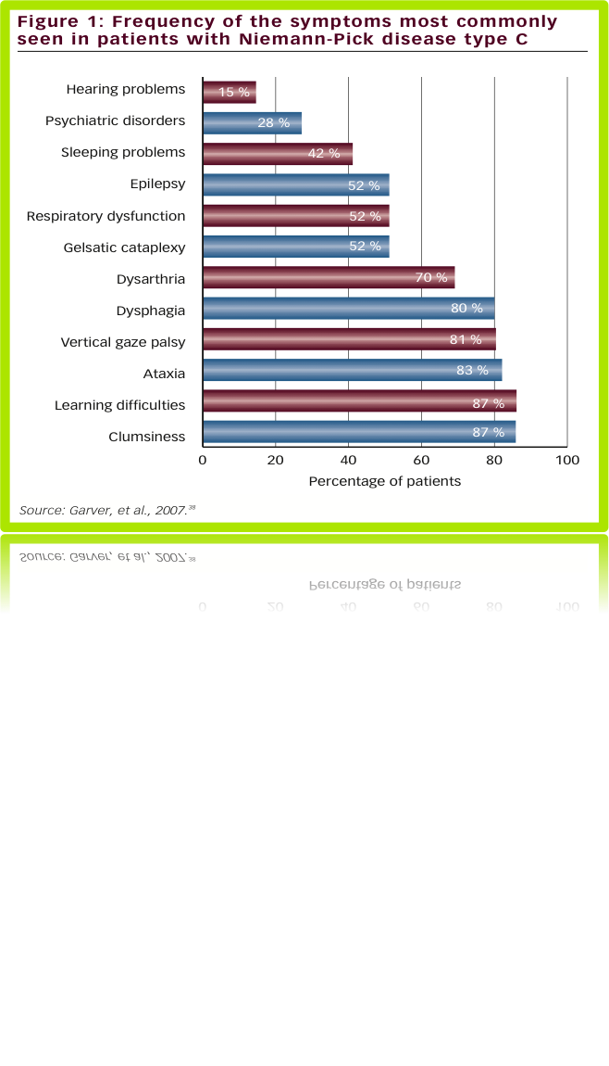
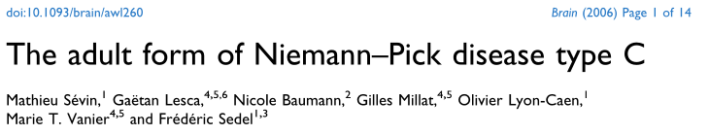
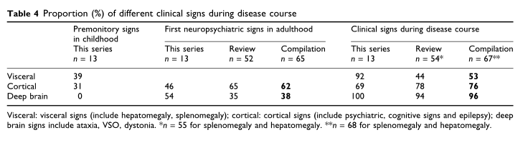
NPC
Frontal Like Syndrome ++
Schizophrenia Like

Slide 31
What do we know :
Cognitive signs in NP-C 1/3
Developmental delays (between 6 and 15-years old) (van de Vlasakker et al., 1994)
Learning disorders and difficulties at school (Klarner et al., 2007; Sevin et al., 2007)
ID is not systematic in NP-C, but when it occurs it is mostly mild impairment (over 50)
Cognitive impairment (Logic, working memory)

Slide 32
Cognitive signs in NP-C 2/3
Psychomotor impairments
Cognitive impairments (logical thinking and abstraction process – working memory)
Speech disorders (word retrieval)
Progressive loss of abilities to perform daily activities

Slide 33
Cognitive signs in NP-C 3/3
Unspecific
Frontal syndrom -Like
No specific cognitive profile for NP-C patients when systematic cognitive testing
Literature on NP-C cognitive impairment is scarce

Slide 34
Schizophrenic disorders associated with NP-C
Rare but increasingly recognised
Few case reports
In all cases, there was a long delay before diagnosis

Slide 35
Other diseases (1/2)
α-mannosidose
  confusion and/or Schizophrenia/Hallucinations with astenia
  Gutschalk A, Harting I, Cantz M, Springer C, Rohrschneider K, Meinck HM. Adult alpha-mannosidosis: clinical progression in the absence of demyelination. Neurology 2004;63(9):1744-6.
β-mannosidose
  ADHD In1/3
  Gourrier E, Thomas MP, Munnich A, Poenaru L, Asensi D, Jan D, et al. [beta] mannosidose: une nouvelle observation. Archives de Pﾈdiatrie 1997;4(2):147.
Metachromatic leucodystrophy
Schizo Like in Héterozygot (Presenting cases) + ID, Rauschka H, Colsch B, Baumann N, Wevers R, Schmidbauer M, Krammer M, et al. Late-onset metachromatic leukodystrophy: genotype strongly influences phenotype. Neurology 2006;67(5):859-63.

Slide 36
Other Diseases (2/2)
gangliosidoses GM2
  30-40 % Psy/Schizophrénie (presenting)
  Neudorfer O, Pastores GM, Zeng BJ, Gianutsos J, Zaroff CM, Kolodny EH. Late-onset Tay-Sachs disease: phenotypic characterization and genotypic correlations in 21 affected patients. Genet Med 2005;7(2):119-23.
Creatin Transport defficiency

Slide 37
DONC…
Comment y penser devant des signes psychiatriques ?

Slide 38
Qu’avons nous vus dans ces cas ?
Résistance au traitement
Prédominance d’hallucination visuelle
Retard de développement
Cependant, la question de l’association Org / Psy est complexe… Prenons l’exemple des Schizo

Slide 39
Schizophrénies Organiques(1/2)
  Impossible d’avoir une vision exhaustive
  Que penser des coïncidences (1% contre 1/100 000) ?

Slide 40
Schizophrénies Organiques(2/2)
Few articles or studies on clinical specific signs, the most extensive is Davison, 1983
Phenomenology of organic schizophrenia is poorly studied (Cutting 87; Barak 2002; Horiguchi 2009…)
C’est pourtant une question essentielle : surtout si les MNM sont traitables : COMMENT LES REPERER DANS LA MASSE DES PATIENTS ?????

Slide 41
Un algorythme1/2
L’objectif est de se concentrer sur les signes psychiatriques atypiques, donc de cerner cette notion mal connue
C’est un travail clinique et pratique

Slide 42
Un algorythme2/2
First order atypical symptoms: Atypical on their own
Second order atypical symptoms: Atypical when associated with at least one of first order

Slide 43
First order atypical features
Atypical by their own
Visual hallucinations
Mental confusion
Catatonia
Fluctuating symptoms
Progressive cognitive decline
Treatment Resistance

Slide 44
Second order atypical features
Considered atypical
if associated with first rank features
Acute Onset
Early Onset
Unusual Side Effects
Intellectual Disability

Slide 45

Un point saillant clinique commun : l’oeil
Disorder | Clinical signs | Context | Eye exam | Biological markers
Wilson | Tremor Dystonia Dysarthria |  | Kayser Fleischer ring | Coeruloplasmin
Urea cycle | Confusion Abdominal pain Nausea vomiting | Protein diet Post surgery Drugs (valproate / corticoids) |  | Ammoniemia
Homocysteinemia (CbS) | Thromboembolism Scoliosis Marfan-like Cerebellar signs | Protein diet Post surgery | Severe myopia Ectopic lens | Homocysteiniemia Methioninemia
Niemann-Pick type C | Dystonia + ataxia Dysarthria Splenomegaly | Neonatal icterus Slow progression | Supranuclear vertical Gaze palsy | Skin-biopsy Filipin test NPC1 and NPC2 gene test
Cerebrotendinous xanthomatosis | Chronic diarrhoea Spastic paralysis |  | Juvenile cataract | Cholesteanoemia
Porphyria | Urine black or red Constipation Confusion Abdominal pain Nausea/ vomiting | Periodic |  | Porphobilinogens (URINE)

Slide 46
L’algorythme
Visual hallucinations
Mental confusion
Catatonia
Fluctuating symptoms
Progressive cognitive decline
Treatment Resistance
Cerebral MRI
Clinical exam
Ophthalmologic exam incl. NVE
Wilson’s
Atypical
psychiatric
signs
CbS Wilson’s
Acute Onset
Early Onset
Unusual Side Effects
Intellectual Disability
NP-C CTX
-ve
Ammonemia
Homocysteine
Abdominal ultrasound
if
Urea Circle Disorders
MTHFR-CbS
-ve
if
Refer and review
NP-C

Slide 47
Merci de votre attention
olivier.bonnot@chu-nantes.fr

